Slide 1
Smart Parking Availability Detector
Mourinho Hernanto
ITAI 1378

Slide 2
The Problem
- Drivers lose time searching for parking
- INRIX study (2017): 17 hrs/year, $345 per driver, $72.7B per year in the U.S.
Survey of ~6,000 drivers in 10 cities. Say it is 2017 data.
- Who cares: drivers, campus and lot operators, small lot owners
- Gap: can't see free spaces before entering, and per-space sensors are expensive
- What solves it: one camera plus a YOLO detector

Slide 3
Solution
Fixed-camera image in, empty/occupied spaces and free count out
Flow diagram:
Camera image → fine-tuned YOLO26n → empty/occupied boxes → counting logic → annotated image + "Free X of Y" + CSV log

Slide 4
Technical Approach
- Technique: object detection
- Model: YOLO26n (Ultralytics), CNN-based, single-stage
- How: transfer learning from pretrained weights
- Framework: Ultralytics / PyTorch
- Why detection: it finds and labels every space in one pass, while classification needs slot coordinates first
- Baseline: pretrained COCO model that just counts cars

Slide 5
Data Plan
- PKLot (Almeida et al., 2015) via Roboflow Public Datasets, CC BY 4.0
- 12,416 images, ~695,900 annotated spaces, using a ~3,000-image subset
- Labels: bounding boxes, empty / occupied
- Own test set: Photos of a real lot
- Link: public.roboflow.com/object-detection/pklot

Slide 6
Success Metrics
Primary: mAP50 ≥ 0.90 on the test split
Secondary: under 1 second per image
mAP50: a predicted box counts as correct at ≥ 50% overlap with the true box
Course scale: above 0.9 is excellent
Extra analysis, no target: accuracy on own photos

Slide 7
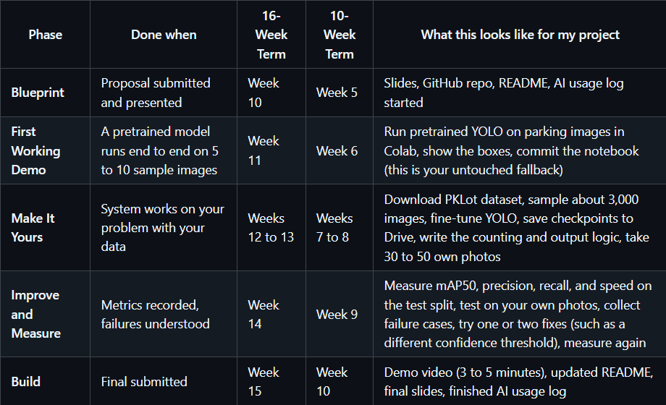
Milestone Plan

Slide 8
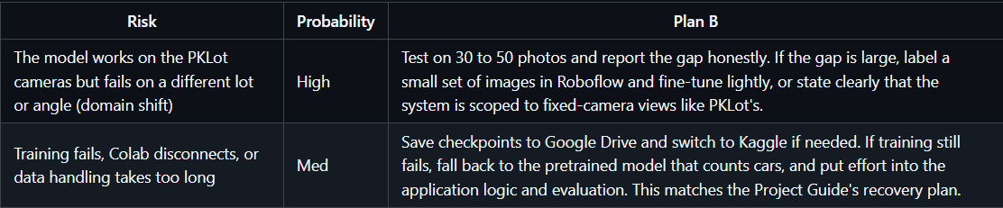
Risks and Resources

Slide 9
Thank You

